Slide 1
Precision Farming using Uppaal Model and simulation using ML Algorithm
Team: Project harvest
Behnoosh Hashemi Hendoukoshi
Chin Chun Kuan
Ramya Manjunath
Veli Ates

Slide 2
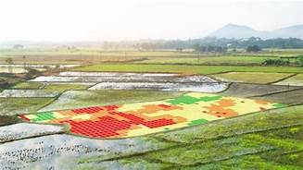
Precision Farming
Revolves around the process of observing, measuring, and responding to various inter and intra-field variability inputs for modern agriculture
An essential in time management, reduction of water and chemical wastage or use, and production of higher yields and healthier crops
All these benefit the farmer’s revenue while reducing the world’s food shortage and pollution of the environment

Slide 3
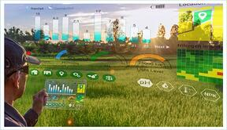
Precision Farming – Contd.
A refined set of cultivation practices and choice of crops based on suitability of land
Elimination of volatility and risk
Waste management
Reduced production costs
Minimum environmental impact
Optimized use of fertilizers
Water management

Slide 4
Precision Farming
Farmers have started to universally embrace precision agriculture for various different reasons.
A farm that uses smart technology is a more profitable farm than the others
A list of some of the precision tools or technology
Drone
Use of smartphone/tablet
Store your data in the cloud
Use of GPS
Variable rate fertilizer

Slide 5
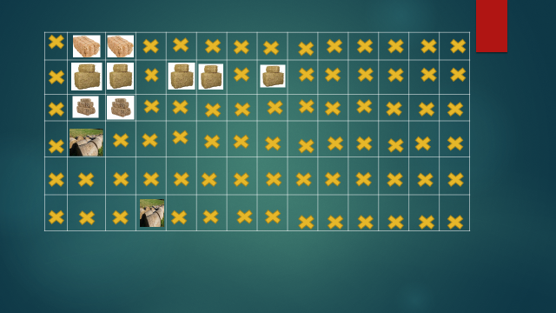
Collecting objects with autonomous vehicles
Bales of straw of different sizes and types
Small Bales
Medium Bales
Big Bales
Weed bales

Slide 6
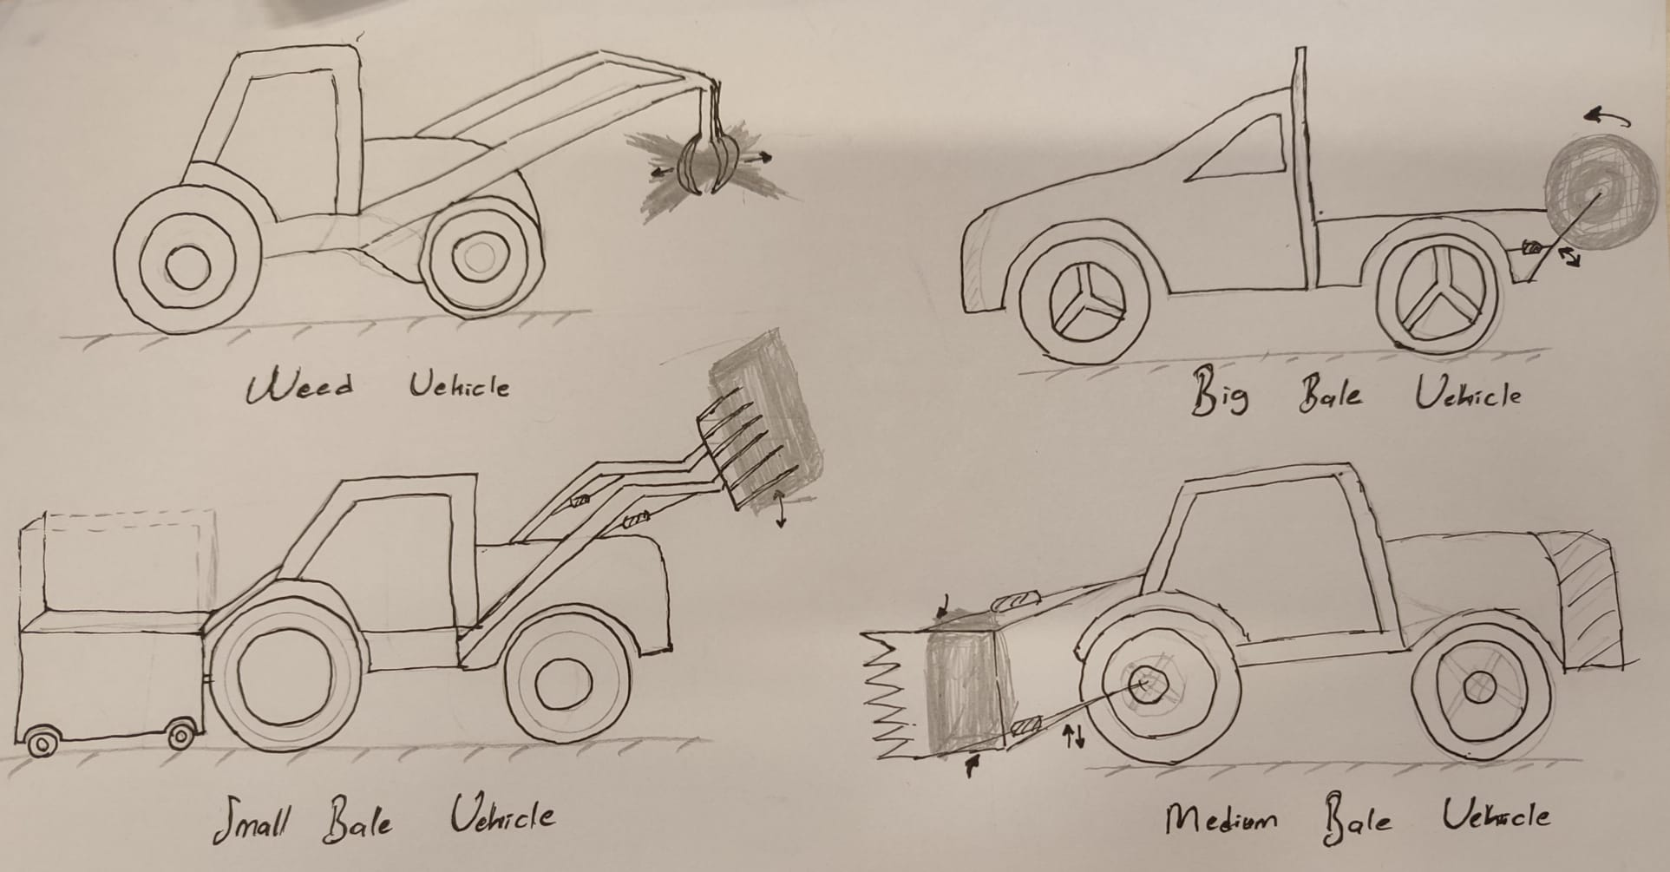
Bale Vehicles – Paper prototype

Slide 7
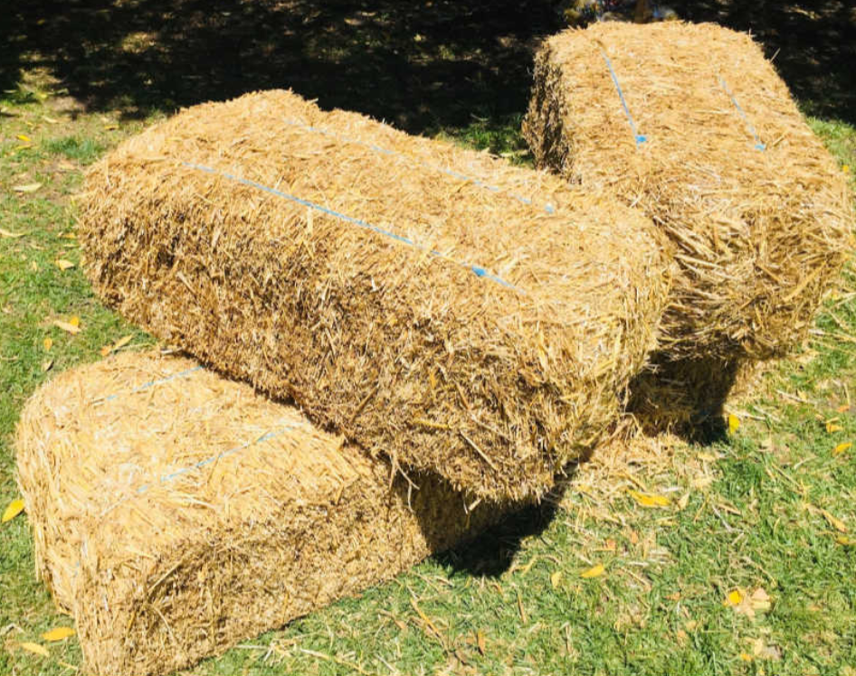
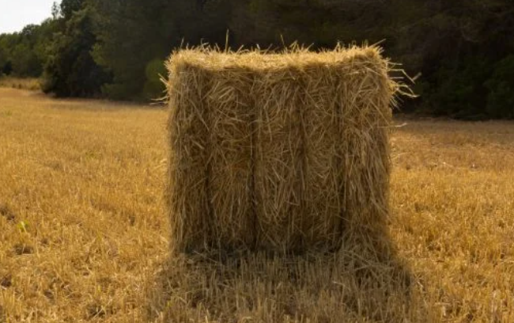
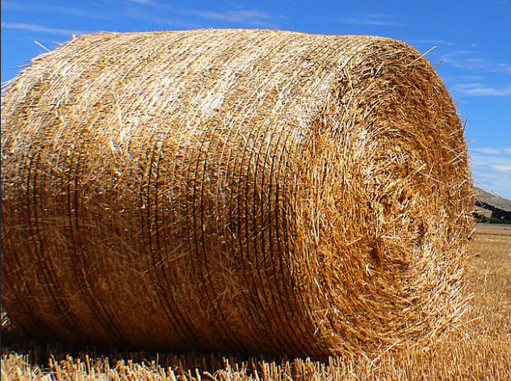
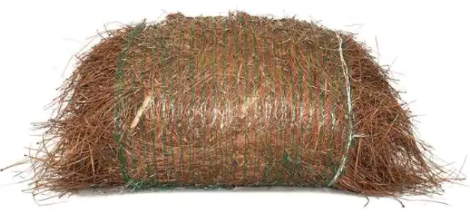
Bale Types
Small bale
Medium Bale
Large Bale
Weed bale
https://www.flickr.com/photos/volvob12b/8098385268/in/photostream/

Slide 8
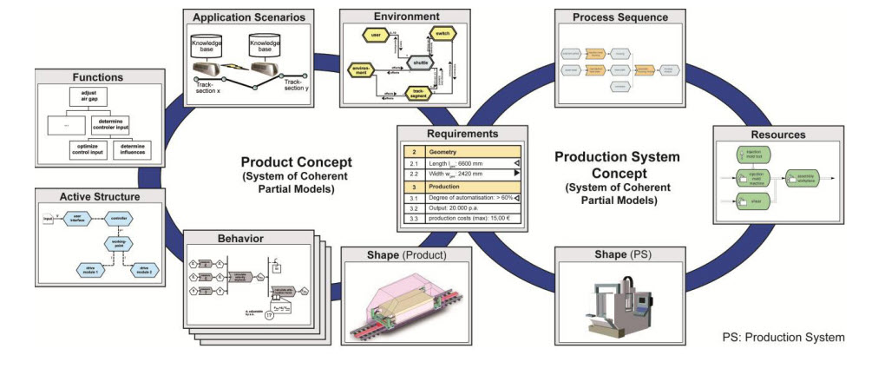
CONSENS DIAGRAM
https://www.researchgate.net/figure/Specification-Technique-CONSENS_fig2_257719699

Slide 9
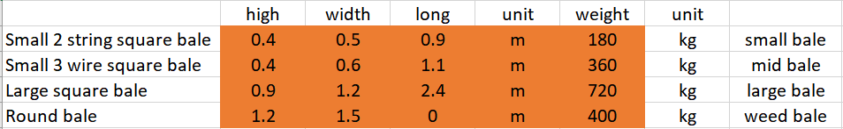
Requirements
Bales dimensions

Slide 10
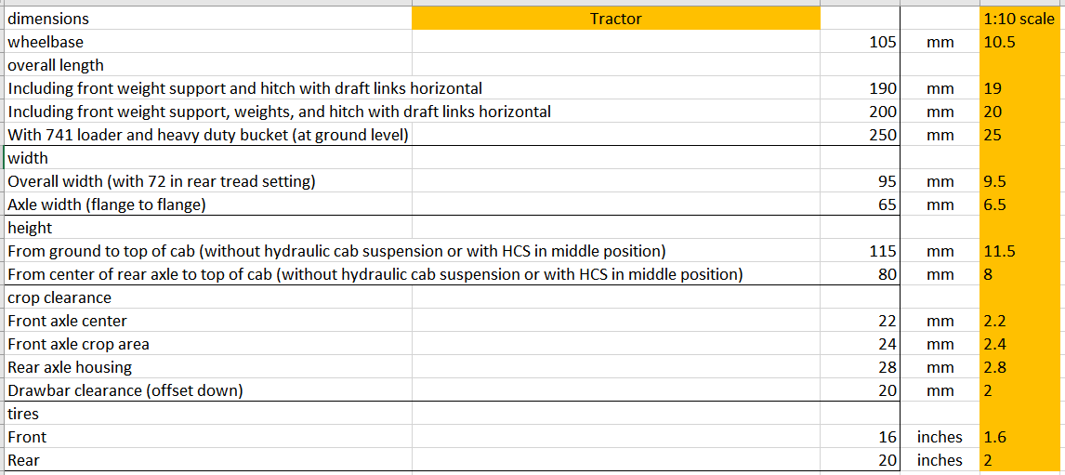
Requirements
Tractor dimensions

Slide 11
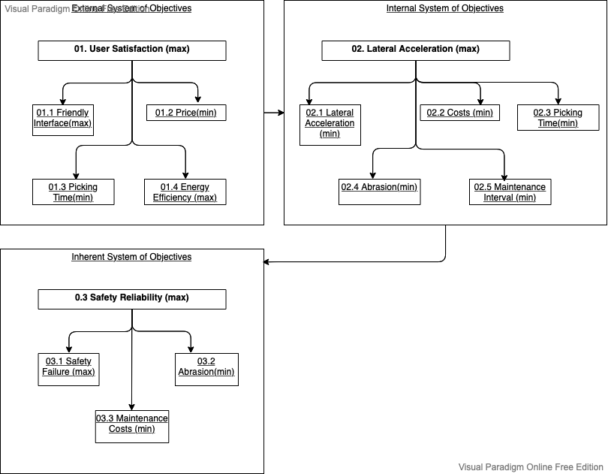
System of Objectives

Slide 12
Shape

Slide 13
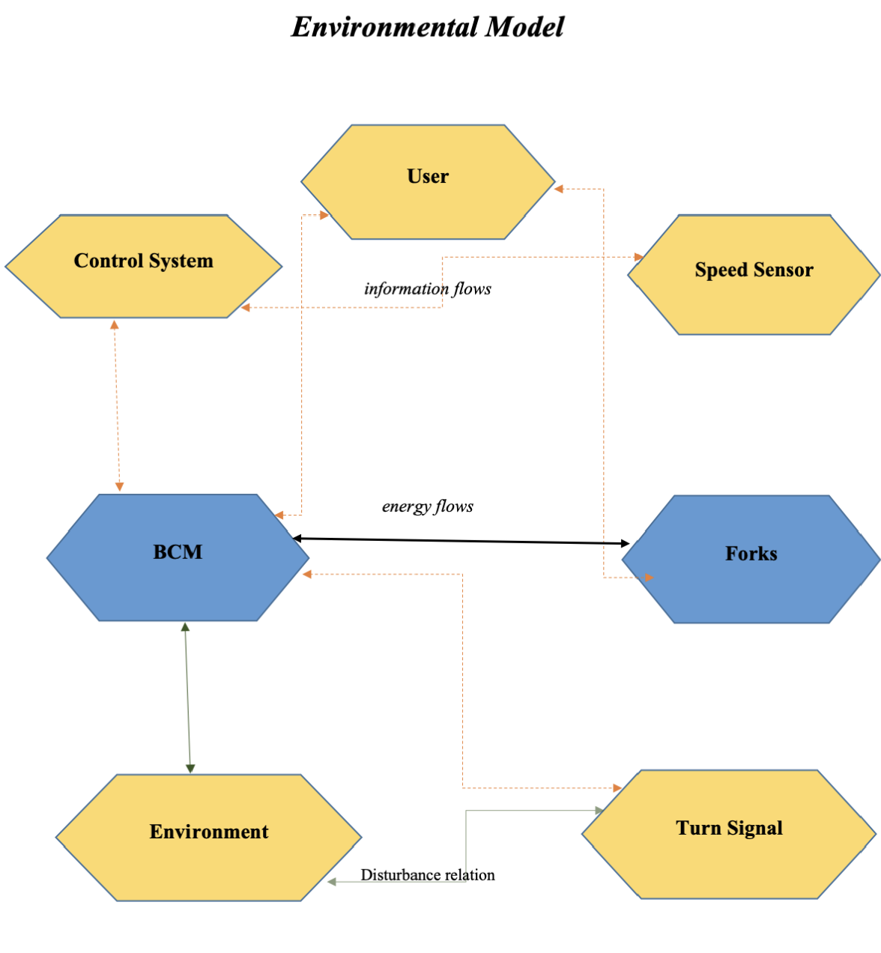
Environment

Slide 14
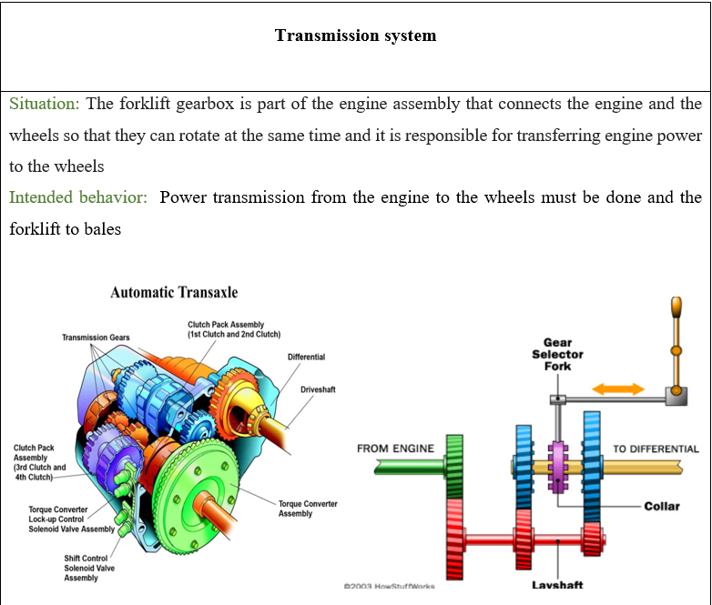
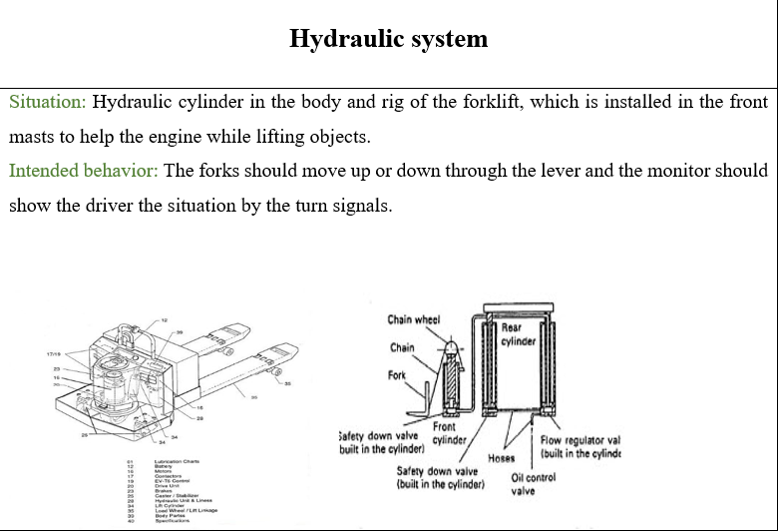
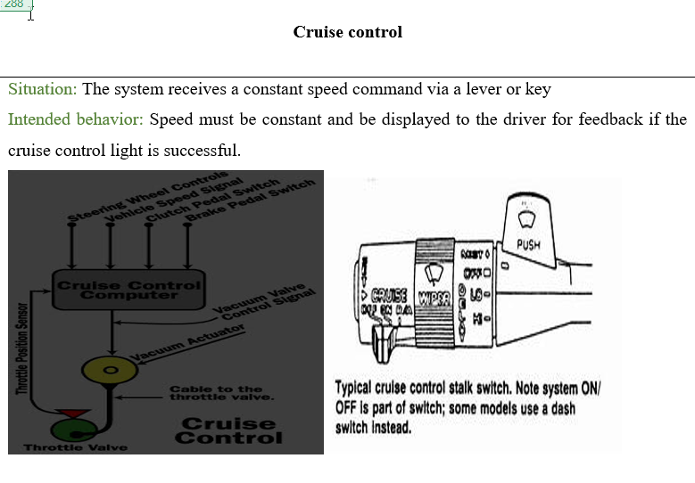
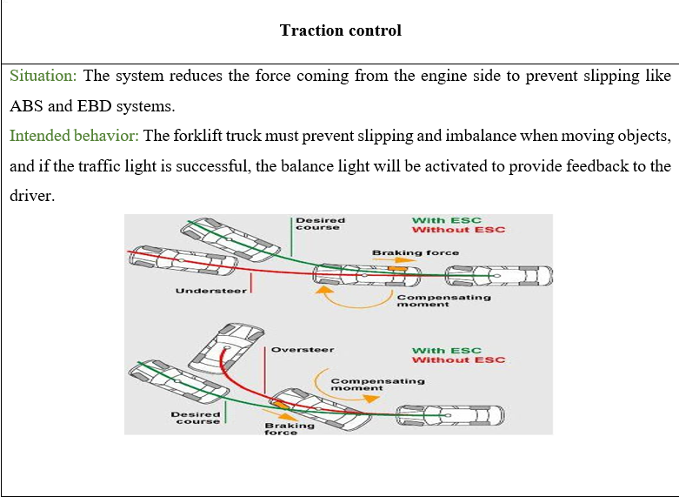
Application Scenarios

Slide 15
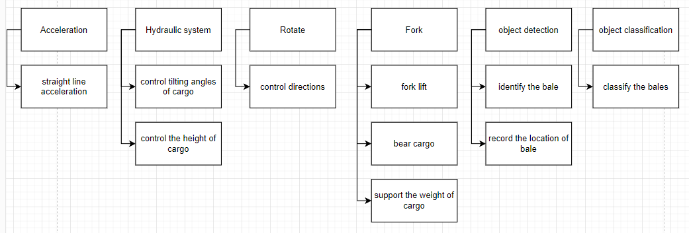
Functions

Slide 16
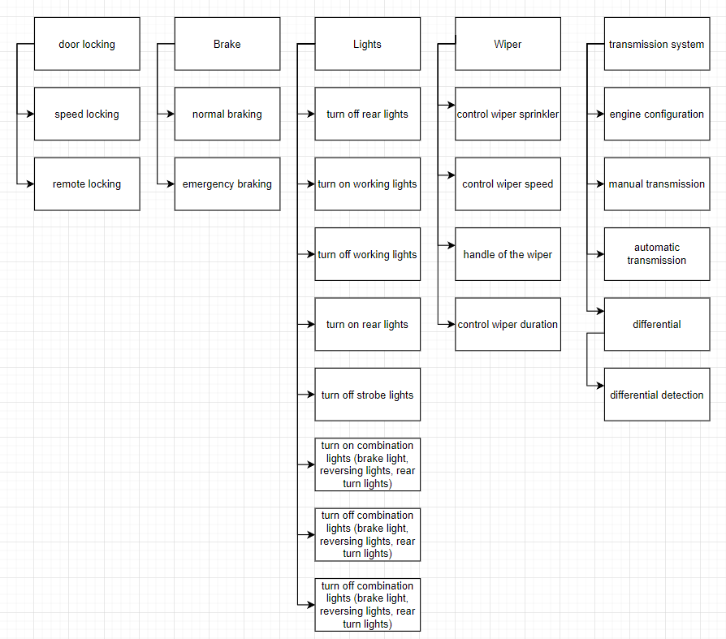
Functions

Slide 17
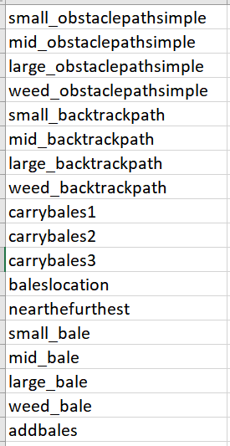
New functions
Functions for carrying the bales

Slide 18
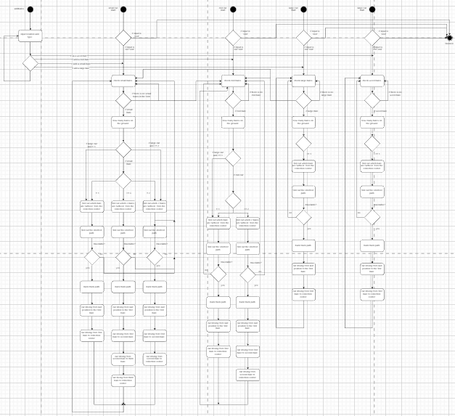
Activity diagram

Slide 19
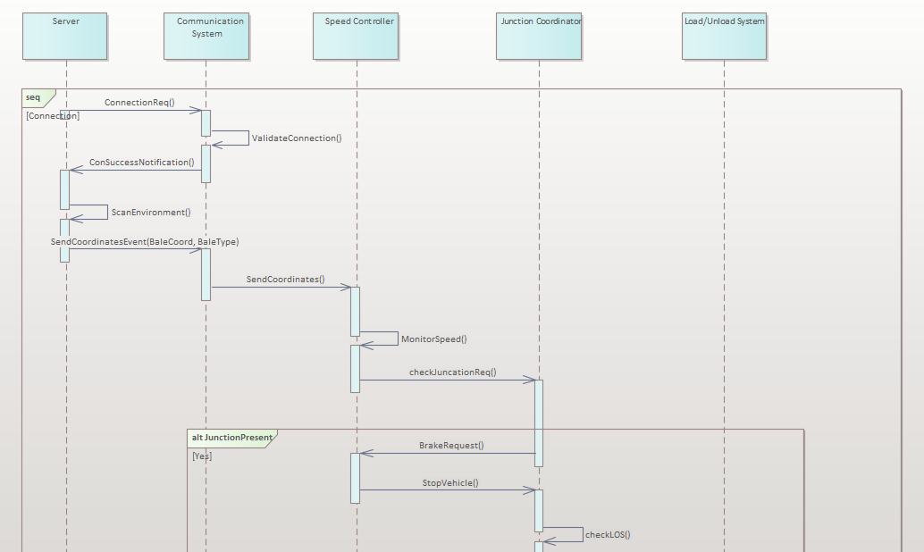
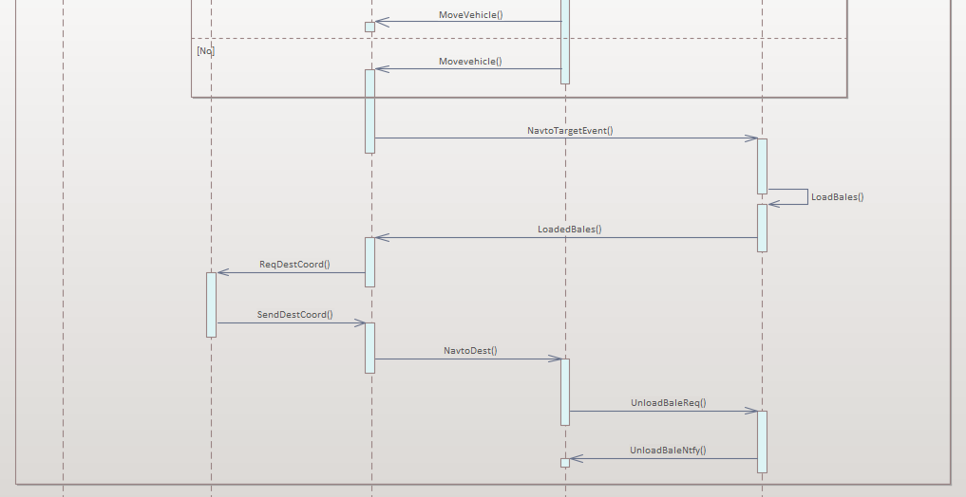
Behaviour - Connection

Slide 20
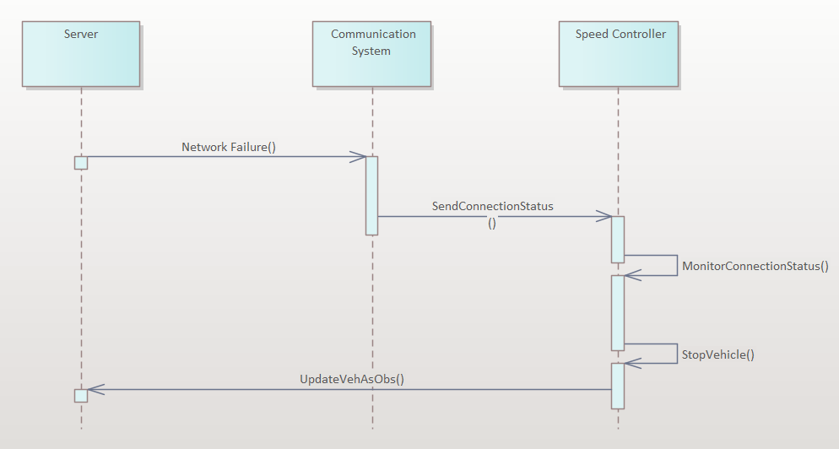
Behaviour – Network failure

Slide 21
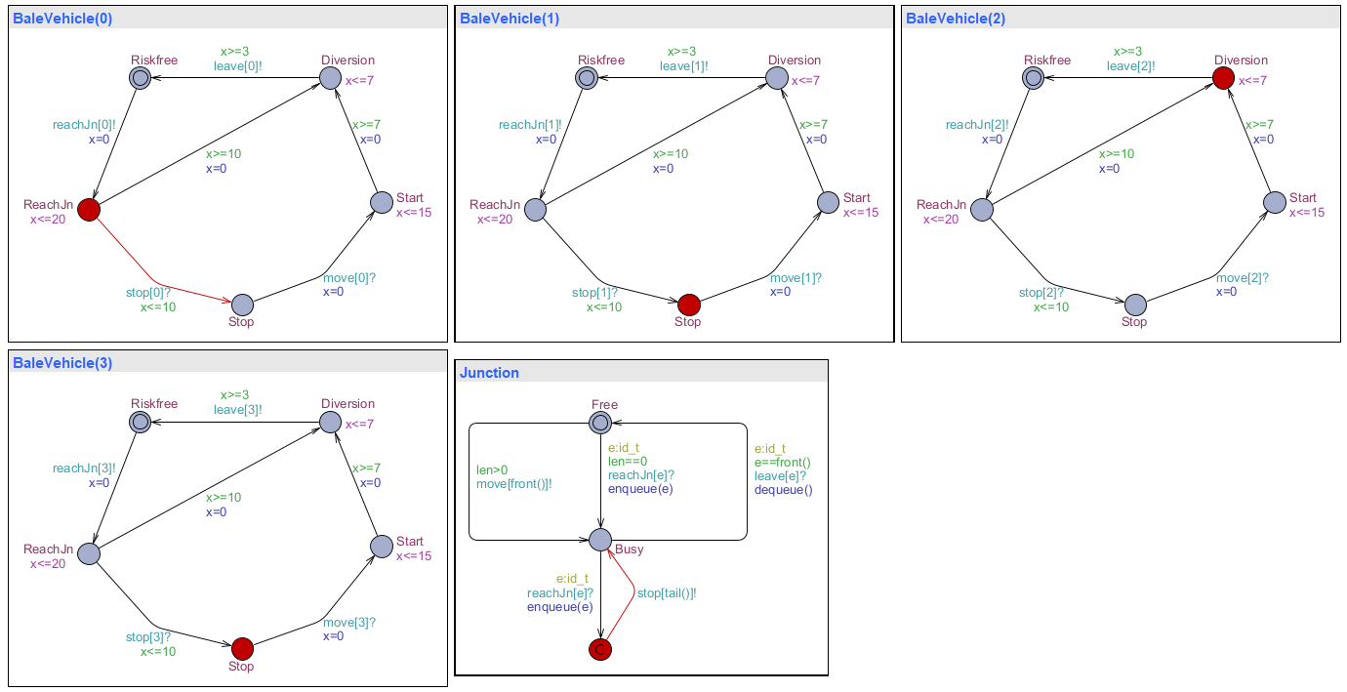
Uppaal Model – Junction Coordination
Junction coordination

Slide 22
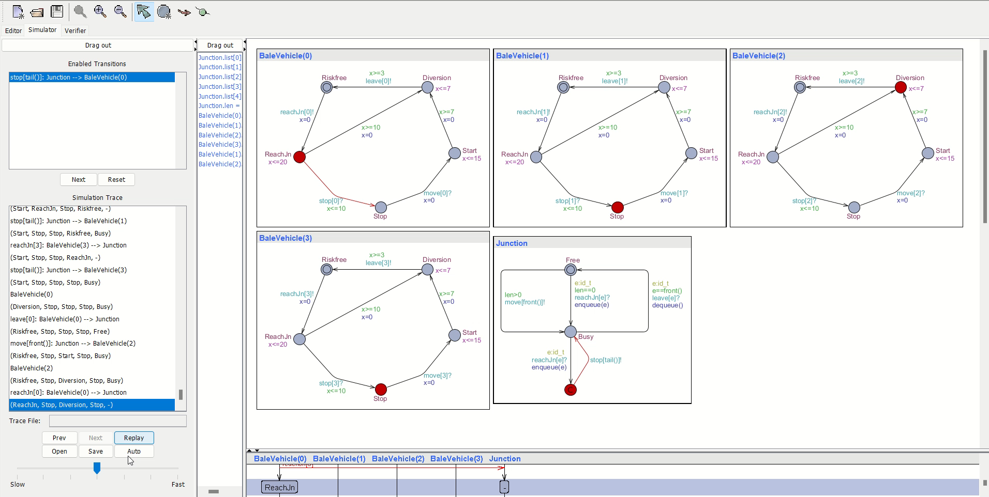

Slide 23
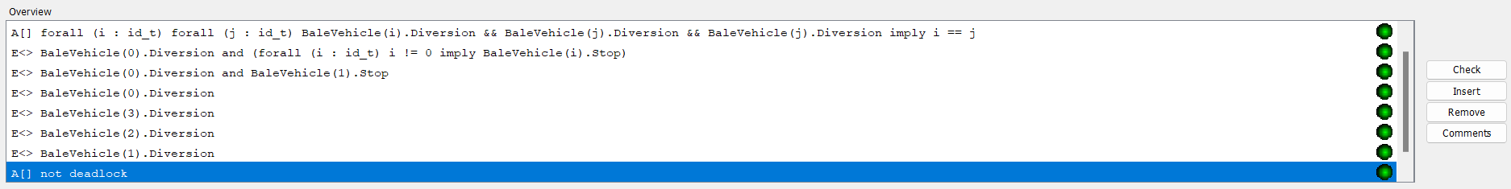
Verification

Slide 24
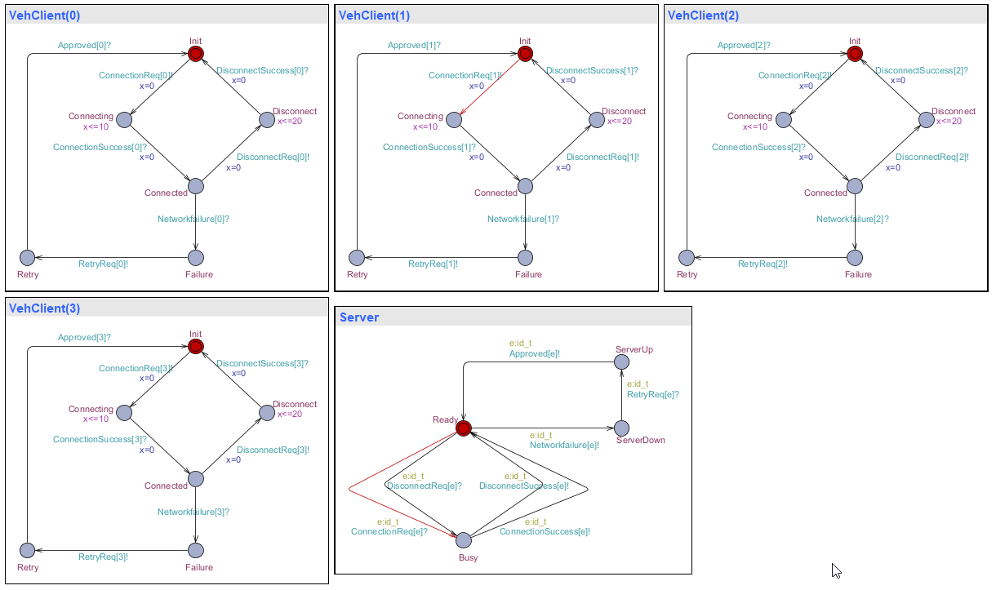
Uppaal Model – Communication System

Slide 25
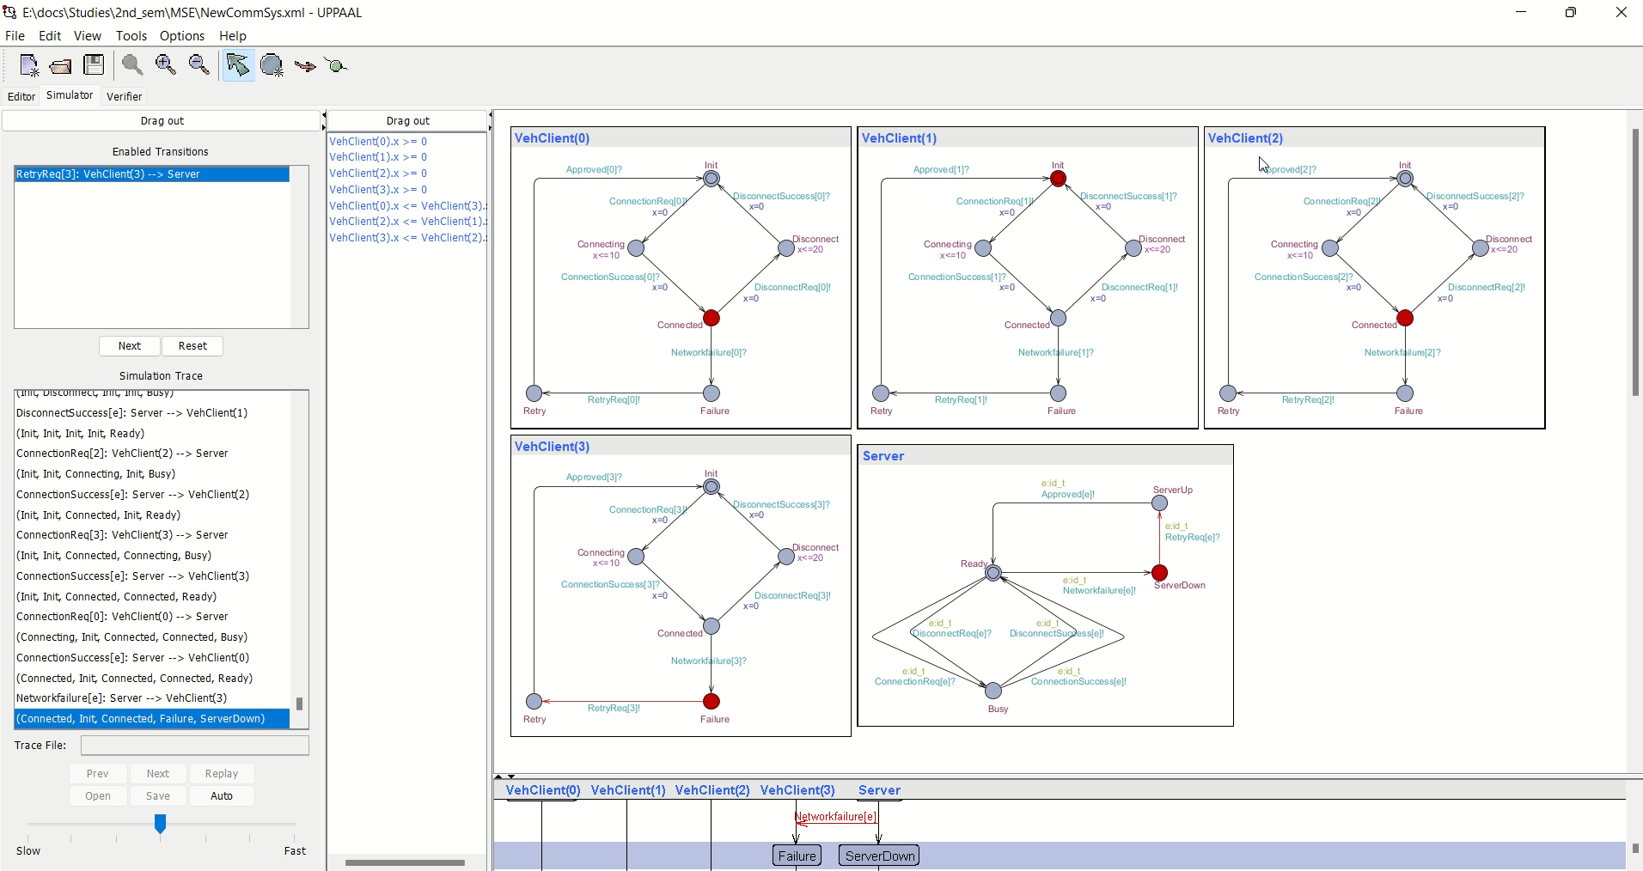
Simulation

Slide 26
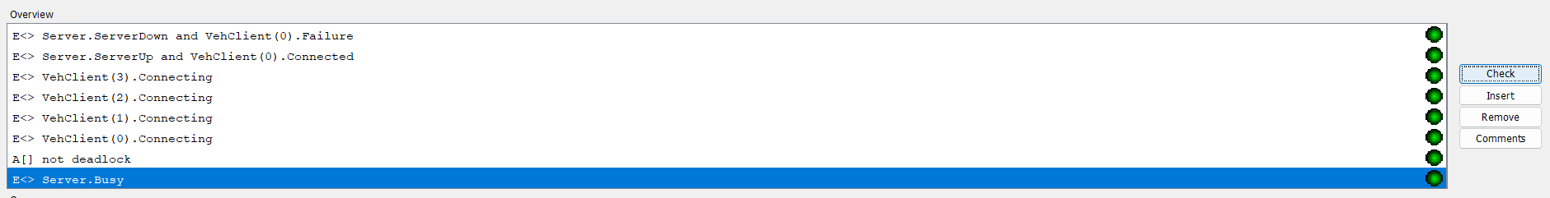
Verification

Slide 27
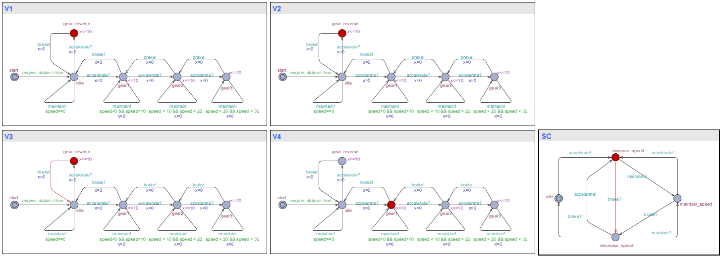
Uppaal Model – Speed Control

Slide 28
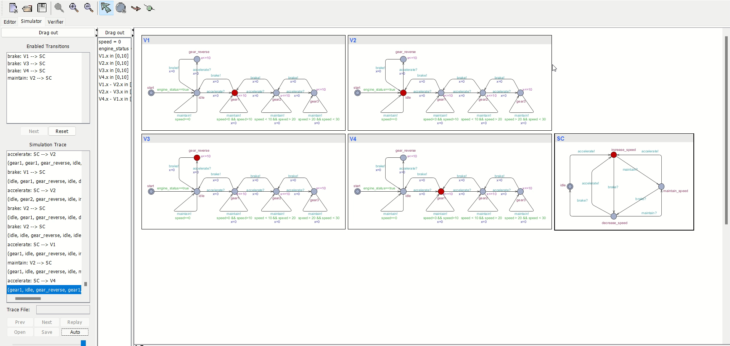
Simulation

Slide 29
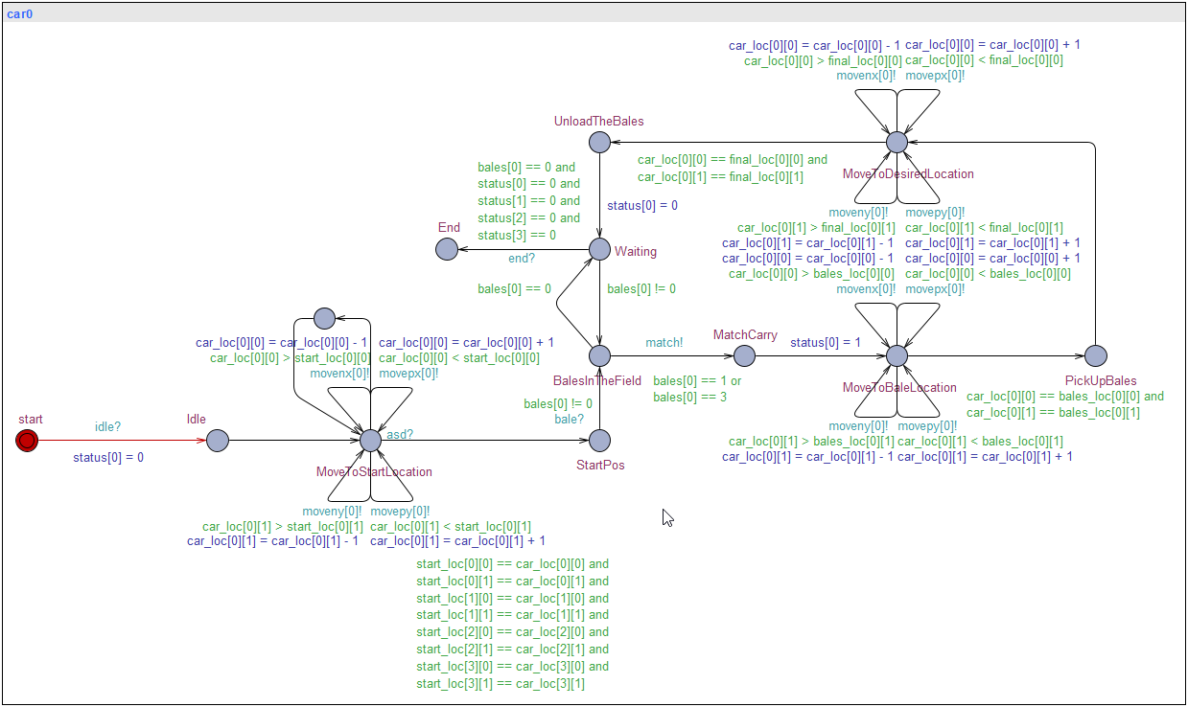
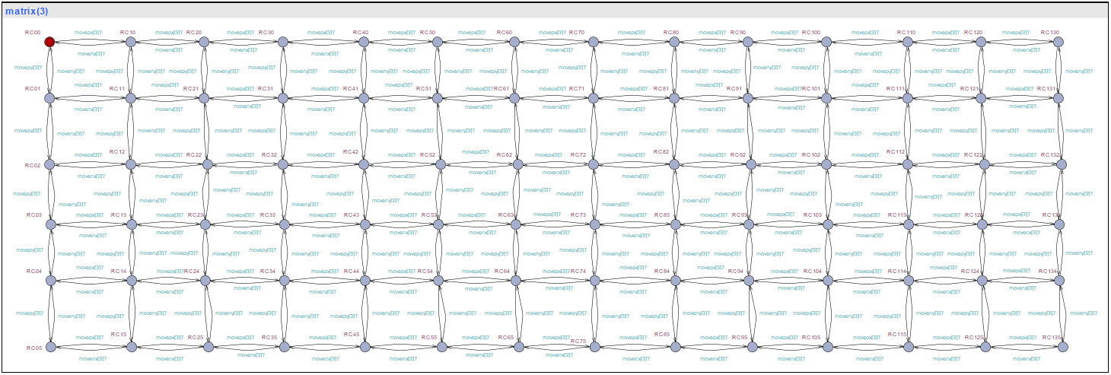
Uppaal Model – Load/Unload Bale

Slide 30
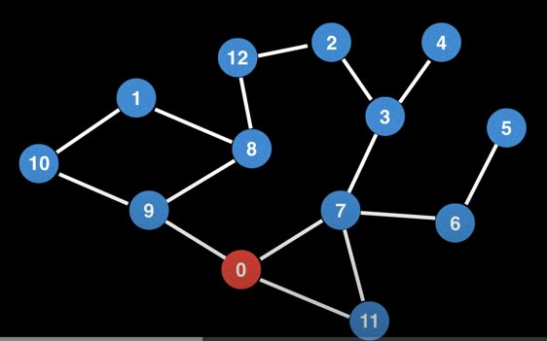
Shortest Path, Start Visiting Paths
From start position,
visit adjacent nodes

Slide 31
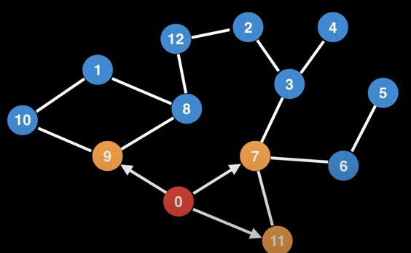
Shortest Path, Keep Visiting Paths
Start visiting nearby nodes

Slide 32
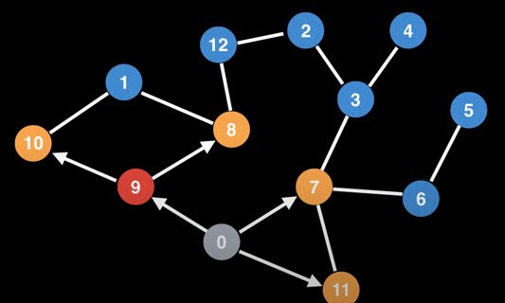
Shortest Path, Keep Visiting Paths
Start from second node,
node 9

Slide 33
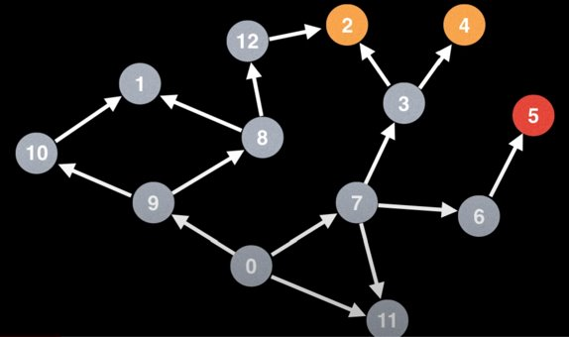
Shortest Path, All Possible Paths are Visited
Keep visiting nodes until all possible paths are visited

Slide 34
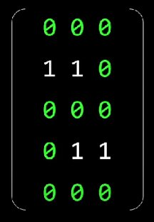
Back Track Path
Selecting the paths

Slide 35
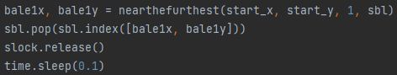
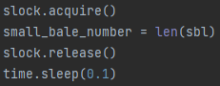
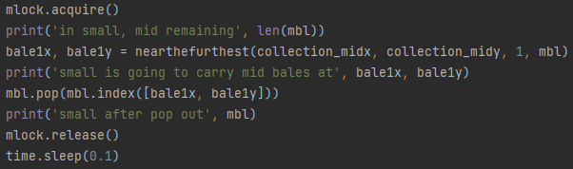
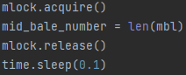
Race condition
Cars cannot pick up the same bale

Slide 36
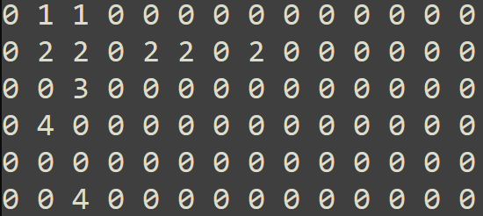
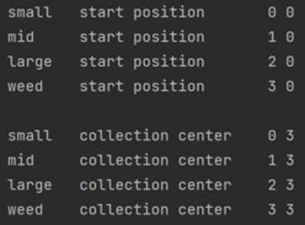
Testing Field

Slide 37
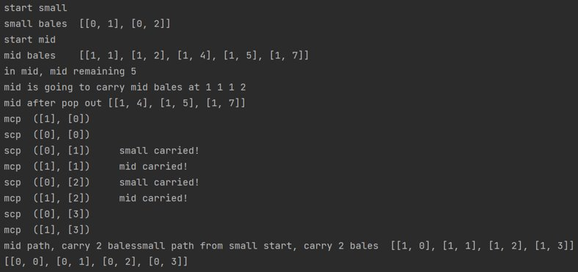
Testing Field
Cars carried the bales and go to the collection center

Slide 38
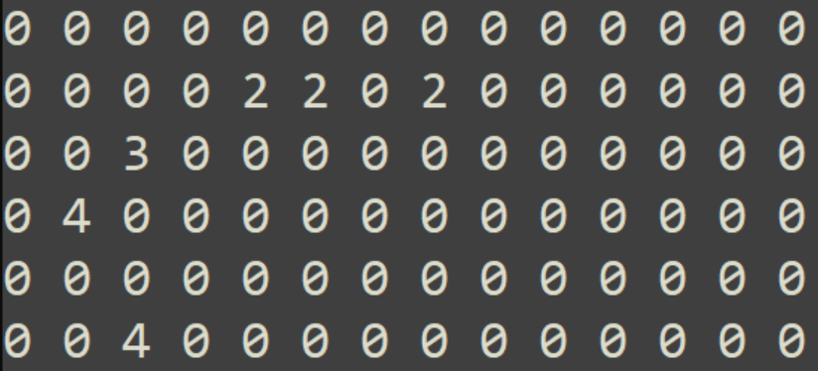
Current field situation
Field after cars carried the bales

Slide 39
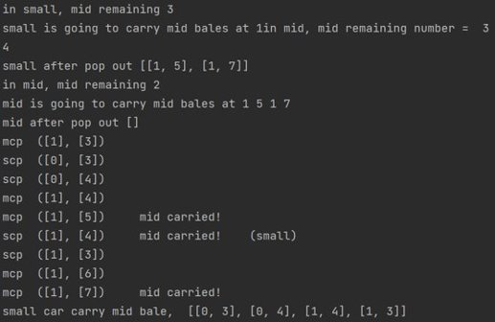
Car can change its roles
Small car pick up
mid bale at 1, 4

Slide 40
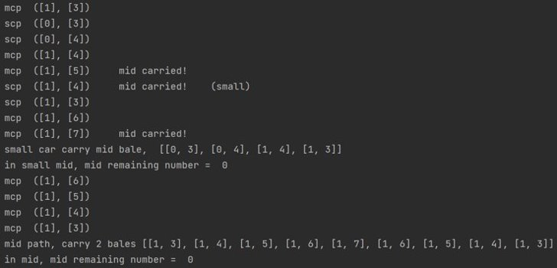
Testing Field
While the same time,
The mid car is picking up two other bales

Slide 41
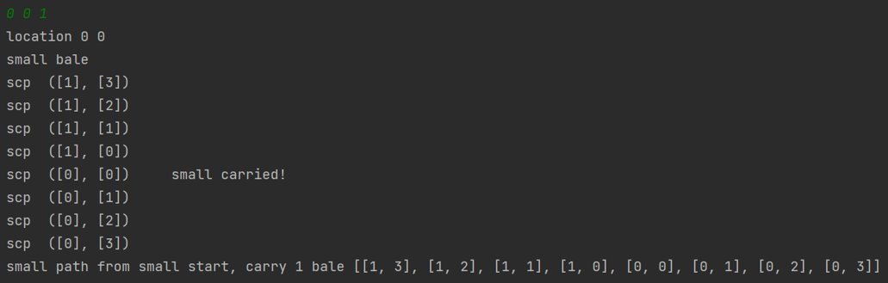
Add bales
Add small bale at 0, 0

Slide 42

Add obstacles
Add new obstacles at
0, 1
1 , 1
2, 1

Slide 43

Current field situation
After obstacles are added

Slide 44

Avoid obstacles after obstacles added
After new obstacles,
The car will avoid obstacles

Slide 45


Real simulation

Slide 46

Real simulation
Remaining bales in the field

Slide 47

Real simulation
Car carrying bales

Slide 48

Real simulation
All the bales have been carried
Check the field
Show the overall steps

Slide 49
THANK YOU
THANK YOU

